Slide 1
Creating Web Applications
Etienne Pollard
ejhp98@ic.ac.uk
www.doc.ic.ac.uk/~ejhp98/lectures

Slide 2
Course Contents
This lecture course will cover:
  Basic CGI scripting
  Basic database interfaces
  Choosing web server software
This lecture course will not cover:
  JavaScript, ActiveX, Dynamic HTML
  Flash, Java Applets, Curl, etc.
First lecture will be very superficial!

Slide 3
Handouts
Lecture slides available online at
www.doc.ic.ac.uk/~ejhp98/lectures/
Handouts will be given out…
…at the end of each lecture

Slide 4
Static Websites vs. Web Apps
Static websites include:
  My Pet Rock
  Etienne’s Homepage

Slide 5
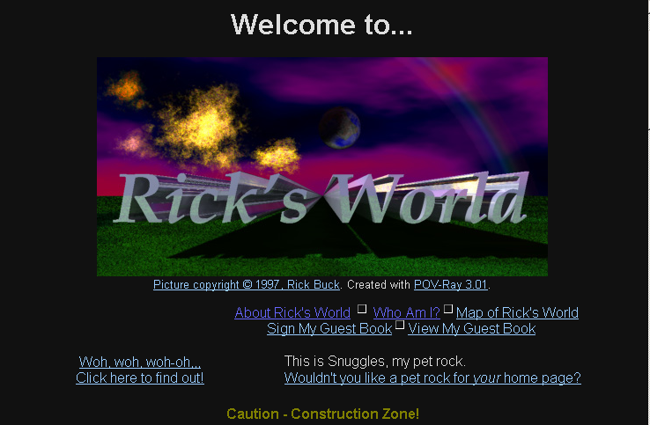

Slide 6
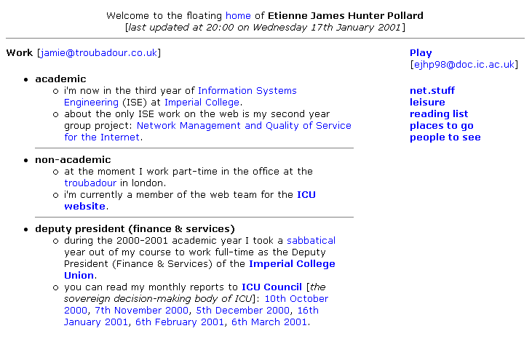

Slide 7
Static Websites vs. Web Apps
Static websites include:
  My Pet Rock
  Etienne’s Homepage
Web Applications include:
  Amazon.co.uk
  CGCU Live!
  BCC News Online
  photo.net

Slide 8
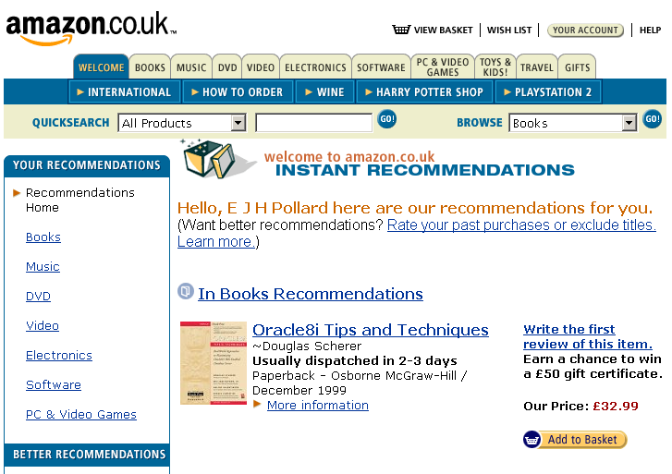

Slide 9
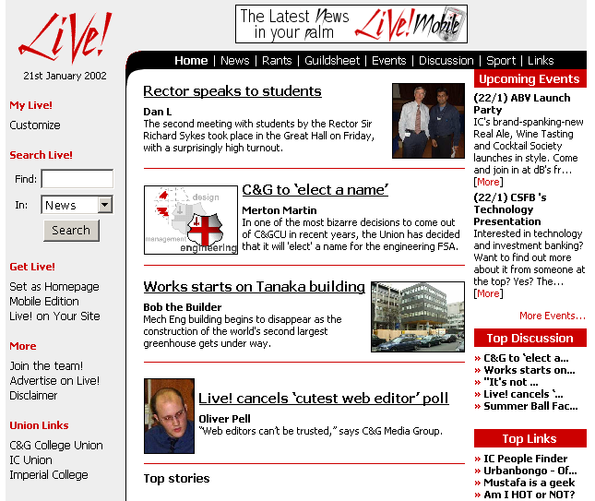

Slide 10
Web Applications
Dynamic
  HTML is generated on-the-fly for the user…
Server-Based
  …by running a program on the web server.
Output can be determined by:
  User input (HTML forms)
  Data on the server (in filesystem or database)
  Both of these!

Slide 11
Running Scripts & Programs On The Web Server (1)
Common Gateway Interface (CGI)
Runs all programs “outside” the web server
For each web browser request, the web server starts new instance of:
  the compiled program, or
  the scripting language interpreter

Slide 12
Client
Server
GET /cgi-bin/date
Web
Browser
Web Server
<result>
Each web page request starts a new copy of the program “outside” the web server
Many simultaneous requests will overload the web server
date
date
date

Slide 13
Running Scripts & Programs On The Web Server (2)
Compiled programs are still run “outside” the web server
Scripts are interpreted “inside” the web server process
Web server includes an interpreter program for the scripting language
  No start-up penalty
  Less memory used

Slide 14
Client
Server
GET /cgi-bin/date
Web
Browser
Web Server
Dispatcher
<HTML>
Each web page request reuses a copy of the program “inside” the web server
Much more scalable than traditional CGI
date
date
date

Slide 15
Choices, choices…
Web server software
  Apache, Microsoft IIS, Zeus, Roxen, etc.
Programming Languages
  C, Perl, PHP, Java, tcl, Cold Fusion, ASP, VBScript, etc.

Slide 16
Next Week’s Lecture
Basic examples of:
  Traditional CGI scripting
  (Apache + Perl)
  Scripting within the Web Server
  (Apache + PHP module)

Slide 17
“Hello World” in Perl
#!/usr/bin/perl
my $counter = 10;
while ($counter) {
print “$counter\n”;
$counter--;
}
print “hello world!\n”;

Slide 18
machine:~/lectures/> perl hello-world
10
9
8
7
6
5
4
3
2
1
hello world!

